Slide 1
Mobile Back-end Assignment 6 Building Architecture
Lee Sin Yi (M031920004)

Slide 2
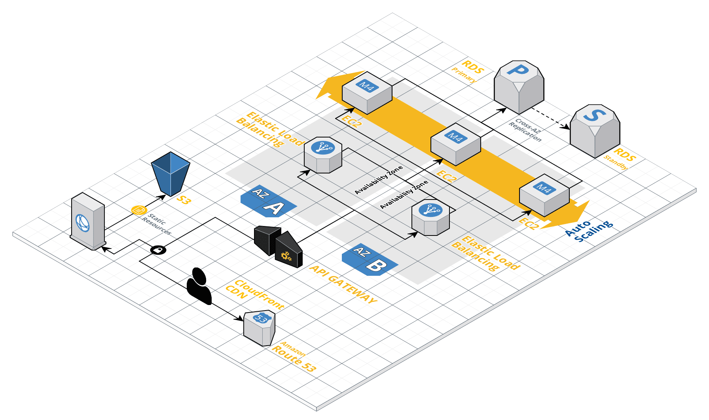
Architecture

Slide 3
AWS Services
AWS Component | Description
RDS | Amazon RDS is a web service that makes it easier to set up, operate, and scale a relational database in AWS Cloud. It provides cost-efficient, resizable capacity for an industry-standard relational database and manages common database administration tasks.
S3 | Amazon S3 is a data store to store and retrieve large amount of data as objects in bucket.
EC2 | Amazon EC2 is resizable compute capacity that take complete control of computing resources and reduce time require for obtaining and boot new server instances to minutes.
Elastic Load Balancing | Elastic Load Balancing automatically distributes incoming application traffic across multiple targets, such as Amazon EC2 instances, containers, IP addresses, and Lambda functions. It can handle the varying load of application traffic in a single Availability Zone or across multiple Availability Zones.

Slide 4
AWS Services
AWS Component | Description
API Gateway | Amazon API Gateway is a fully managed service that acts as the "front door" for applications to access data, business logic, or functionality from backend services. It handles tasks involved in accepting and processing concurrent API calls.
CloudFront | Amazon CloudFront is a fast content delivery network (CDN) service that securely delivers data, videos, applications, and APIs to customers globally with low latency, high transfer speeds, all within a developer-friendly environment.
Route 53 | Amazon Route 53 is a highly available and scalable cloud DNS web service. It is designed to give developers and businesses an extremely reliable and cost effective way to route end users to Internet applications by translating names like www.example.com into the numeric IP addresses like 192.0.2.1 that computers use to connect to each other.

Slide 5
Budget
Category | Type | Region | Count | Unit price | Total cost | Instance type | Instance size | Platform | Role | Engine | Data | Cache size (GB) | API calls (M)
compute | ec2 | us-east-1 | 3 | $73.00 | $219.00 | m4 | large | linux
storage | s3 | us-east-1 | 1 | $0.23 | $0.23 |  |  |  |  |  | 10
networking | elb | us-east-1 | 2 | $22.27 | $44.54 |  |  |  |  |  | 10
database | rds | us-east-1 | 1 | $127.75 | $127.75 | m4 | large |  | primary | mysql
database | rds | us-east-1 | 1 | $127.75 | $127.75 | m4 | large |  | standby | mysql
appservices | apigateway | us-east-1 | 1 | $45.24 | $45.24 |  |  |  |  |  |  | 1.6 | 5

Slide 6
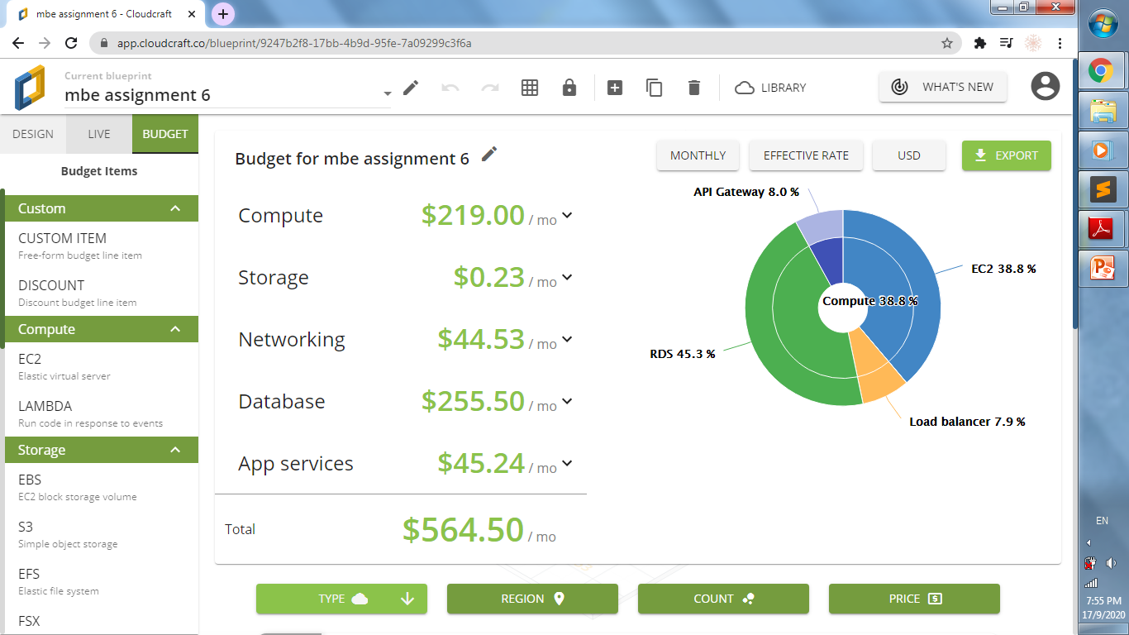
Budget

